Slide 1
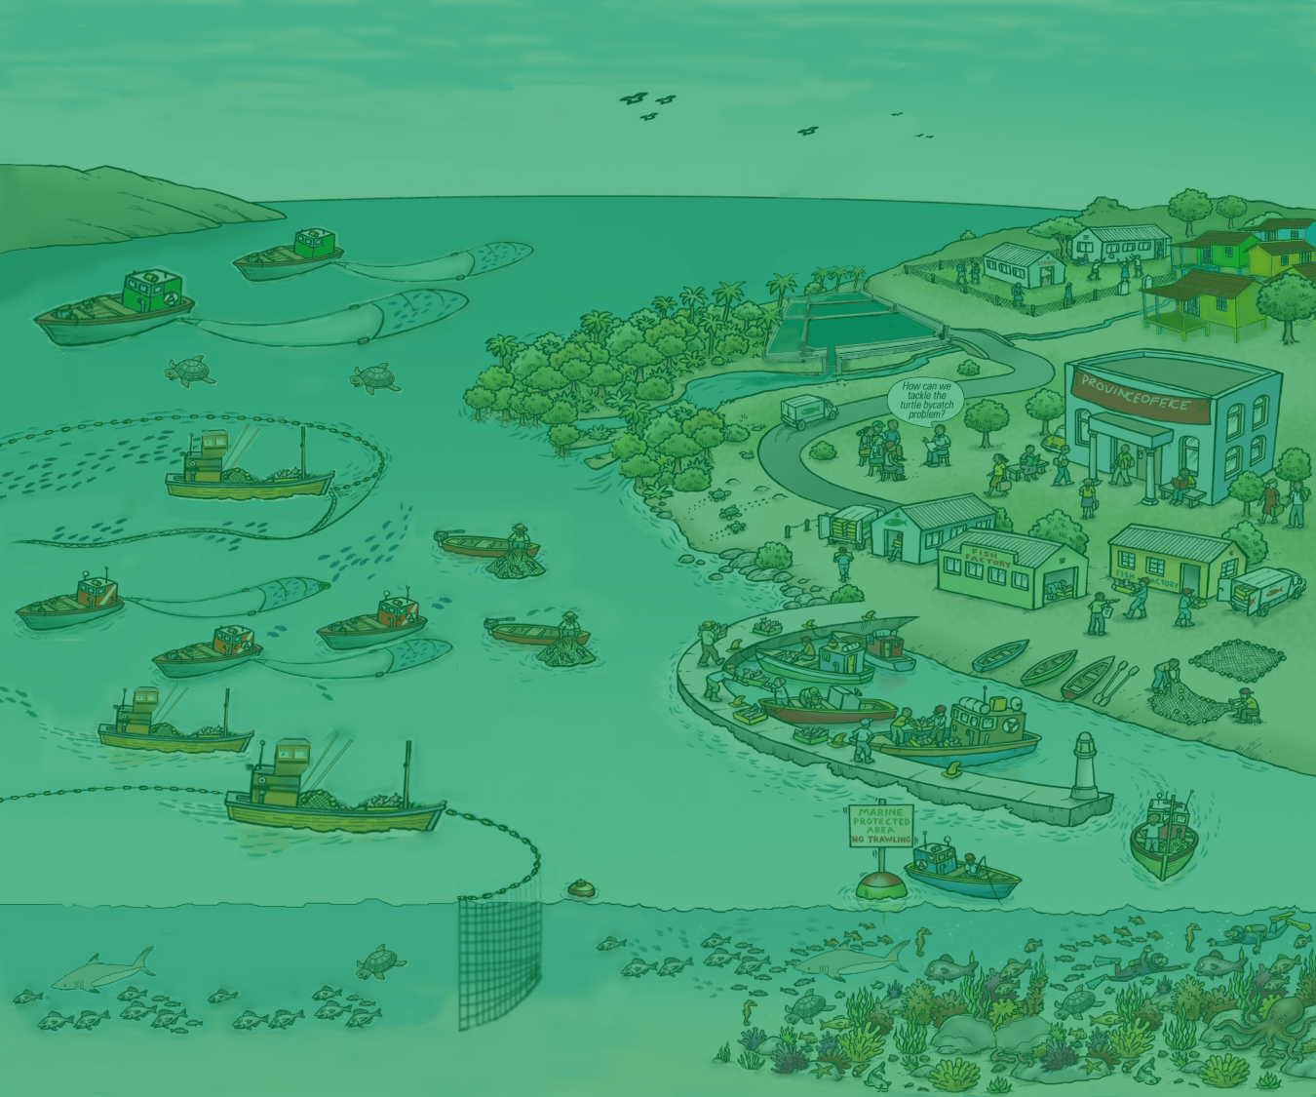

10. EAFM
Next Steps
Version 1

Slide 2
Next Steps
What are the challenges and opportunities for moving toward an EAFM?
What are the benefits of an EAFM?
2
Notes:
Self explanatory

Slide 3
Next Steps
What are next steps that can be taken to move toward an EAFM?
What are ways to promote an EAFM?
3
Notes:
STARTUP A is getting organized and preparing the ground.
Many of the tasks in STARTUP A are only done once at the beginning of the process.

